Slide 1
FIFA
Sponsorship Excitement Factor

Slide 2
Brief:
You are working for an advertising analytics consulting company. Your client, a name brand television network, needs help deciding how to re-formulate the pricing structure for new customers, but also incentivize existing clients to convert to new partnerships sponsors for teams and players.
Goals:
Determine a reasonable metric to decide how exciting a game is
Engineer this feature using existing data
Suggest a pricing structure tied to the overall value associated with "game excitement"

Slide 3
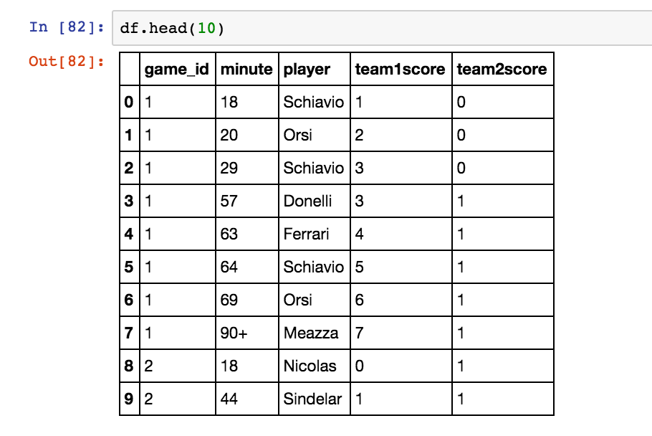
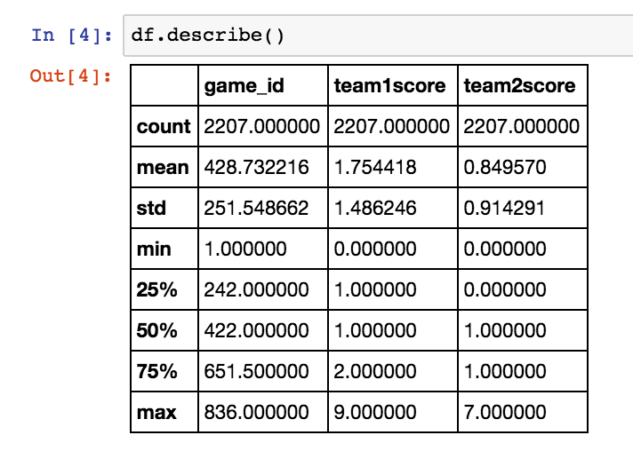
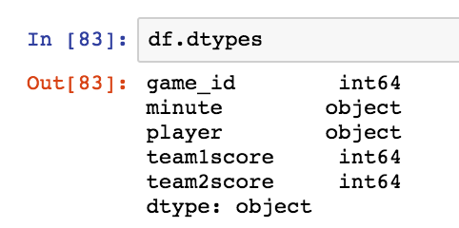
EDA
Goals per Game

Slide 4
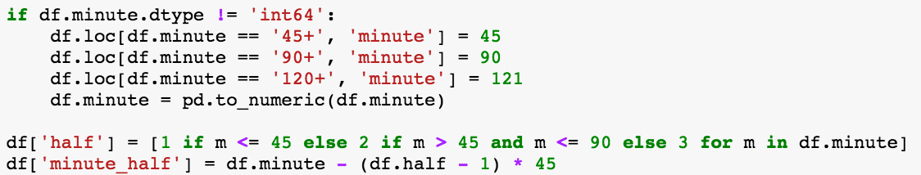
Some Cleanup and Feature Engineering

Slide 5
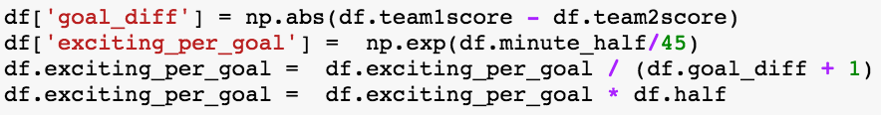
Excitement
An excitement score for each goal was calculated taking into account:
Goal difference at the time
The minute of which half (assume later in the half is more exciting)
The half in which the goal was scored
For each game… The Excitement Score is the sum of all goal excitement scores!

Slide 6
The most Exciting Game!

Slide 7
Results
‘Excitement Factor’ for:
Each Game – Identify games which cost more to sponsor
Each Player – Identify players which cost more to sponsor
Excitement Score By Game
PLAYER | EXCITEMENT SCORE
Muller | 27.35
Seeler | 19.29
Fontaine | 16.72
Ronaldo | 16.54
Rahn | 16.18
Klose | 15.14
Klinsmann | 13.89
Leanidas | 13.02
Hernandez | 12.69
Lato | 12.58
$$$$$
$

